Slide 1
Lecture -31-34
Kinetics of particle
Energy, momentum, impulse

Slide 2
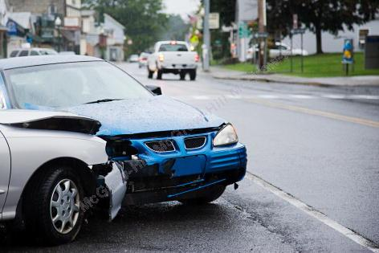
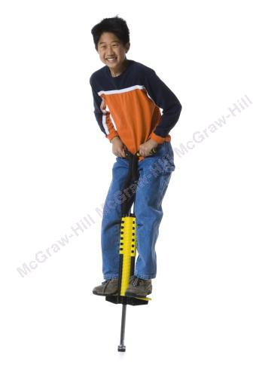
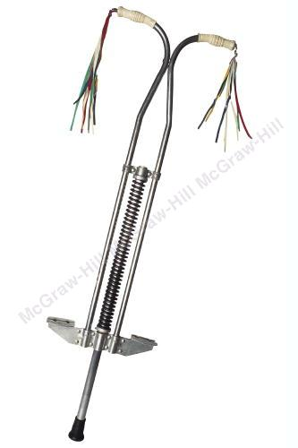
Energy and Momentum method
The pogo stick allows the boy to change between kinetic energy, potential energy from gravity, and potential energy in the spring.
Accidents are often analyzed by using momentum methods.

Slide 3
Introduction
Previously, problems dealing with the motion of particles were solved through the fundamental equation of motion,
The current chapter introduces two additional methods of analysis.
Method of work and energy: directly relates force, mass, velocity and displacement.
Method of impulse and momentum: directly relates force, mass, velocity, and time.

Slide 4
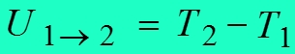
Introduction
Forces and Accelerations
Velocities and Displacements
Velocities and Time
Newton’s Second Law (last chapter)
Work-Energy
Impulse-Momentum

Slide 5
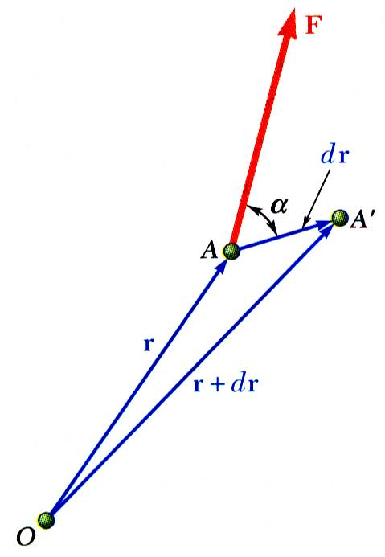
Work of a force
Differential vector is the particle displacement.
Work of the force is
Work is a scalar quantity, i.e., it has magnitude and sign but not direction.
Dimensions of work are
Units are

Slide 6
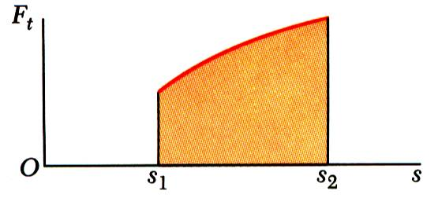
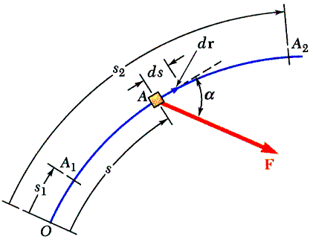
Work of a force
Work of a force during a finite displacement,
Work is represented by the area under the curve of F_{t} plotted against s.
F_{t} is the force in the direction of the displacement ds

Slide 7
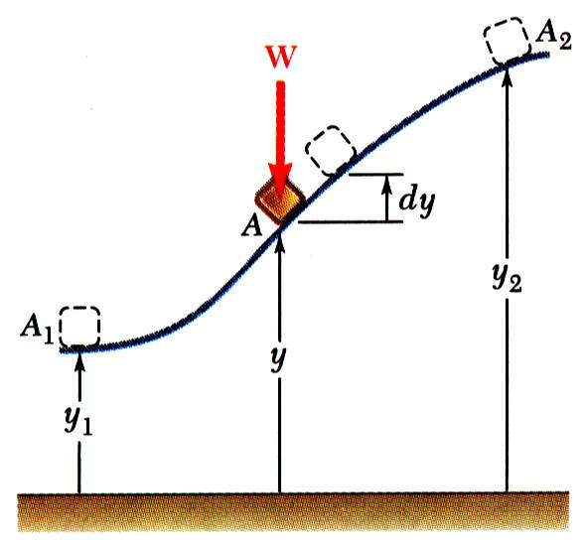
Work of a force
Work of the force of gravity,
Work of the weight is equal to product of weight W and vertical displacement Δy.

Slide 8
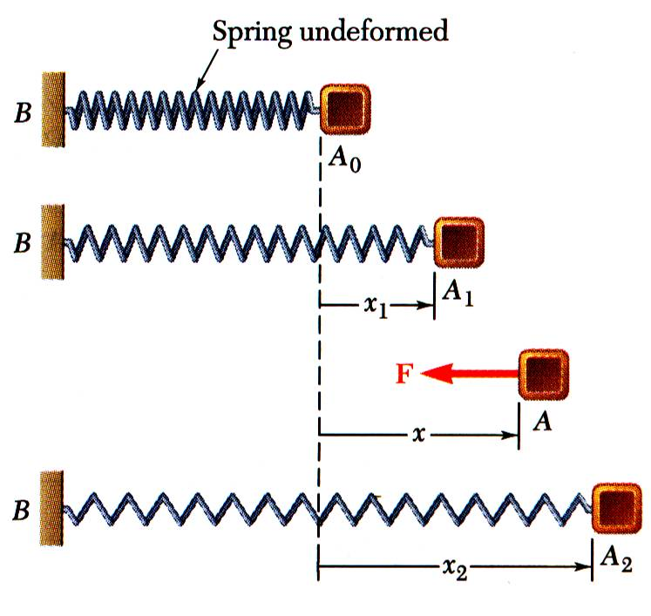
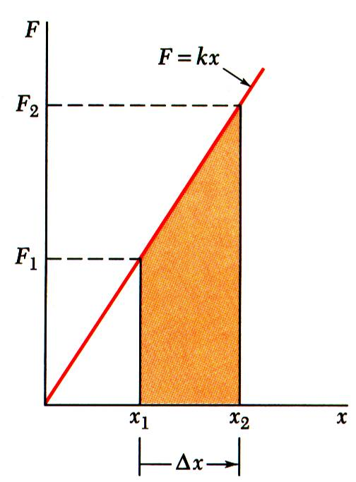
Work of a spring force
Magnitude of the force exerted by a spring is proportional to deflection,
Work of the force exerted by spring,
Work of the force exerted by spring is positive when x₂ < x₁, i.e., when the spring is returning to its un-deformed position.
Work of the force exerted by the spring is equal to negative of area under curve of F plotted against x,

Slide 9
Work of a spring force
As the block moves from A₀ to A₁, is the work positive or negative? -ve
As the block moves from A₂ to A_{o}, is the work positive or negative? +ve
Displacement is in the opposite direction of the force.

Slide 10
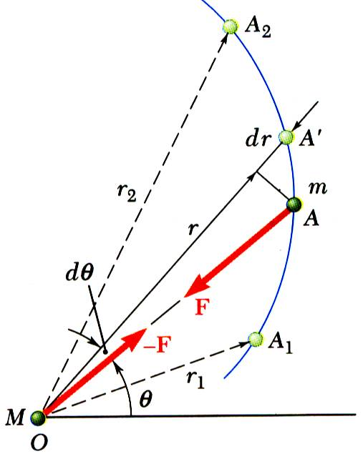
Work of a gravitational force
Work of a gravitational force (assume particle M occupies fixed position O while particle m follows path shown),

Slide 11
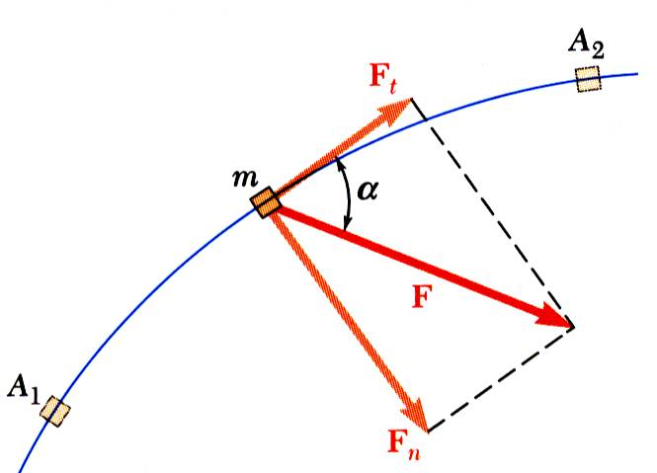
Principle of work and energy
Consider a particle of mass m acted upon by force
Integrating from A₁ to A₂ ,
The work of the force is equal to the change in kinetic energy of the particle.
Units of work and kinetic energy are the same:

Slide 12
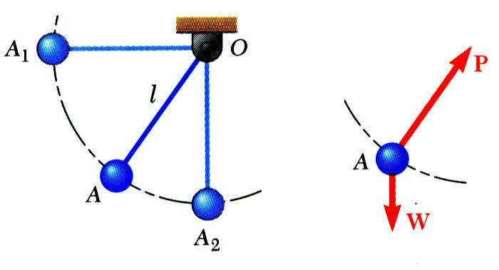
Principle of work and energy (application)
Force acts normal to path and does no work.
The bob is released from rest at position A₁. Determine the velocity of the pendulum bob at A₂ using work & kinetic energy.
Velocity is found without determining expression for acceleration and integrating.
All quantities are scalars and can be added directly.
Forces which do no work are eliminated from the problem.

Slide 13
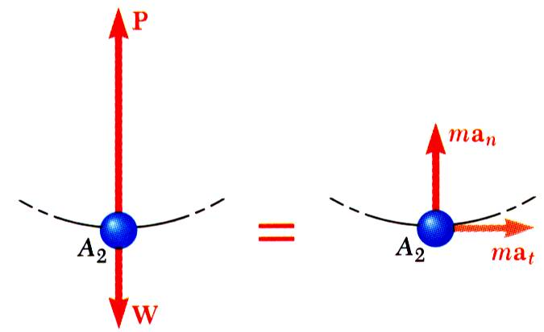
Principle of work and energy (application)
Principle of work and energy cannot be applied to directly determine the acceleration of the pendulum bob.
Calculating the tension in the cord requires supplementing the method of work and energy with an application of Newton’s second law.
As the bob passes through A₂ ,

Slide 14
Power and energy
Dimensions of power are work/time or force*velocity. Units for power are

Slide 15
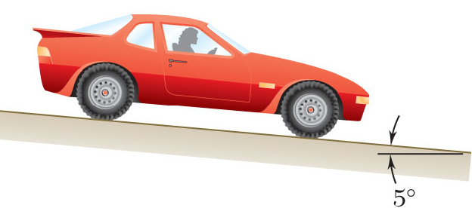
Problem-1
SOLUTION:
Evaluate the change in kinetic energy.
Determine the distance required for the work to equal the kinetic energy change.
An automobile weighing 4000 lb is driven down a 5º incline at a speed of 60 mi/h when the brakes are applied causing a constant total breaking force of 1500 lb.
Determine the distance traveled by the automobile as it comes to a stop.

Slide 16
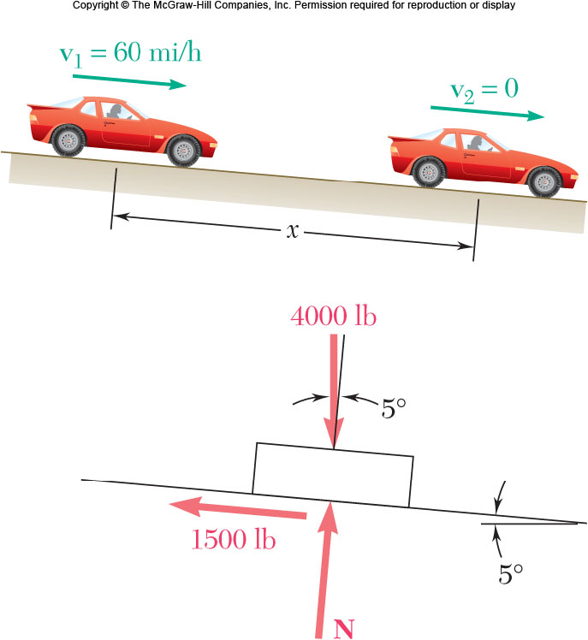
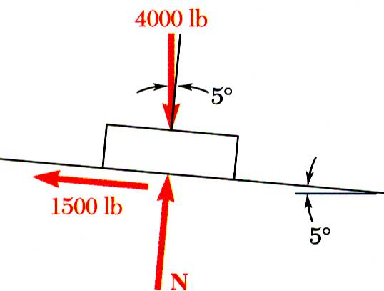
Problem-1
SOLUTION:
Evaluate the change in kinetic energy.
Determine the distance required for the work to equal the kinetic energy change.

Slide 17
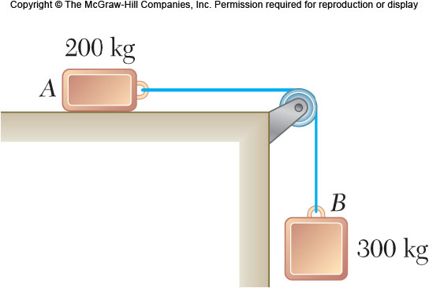
Sample Problem 2
SOLUTION:
Apply the principle of work and energy separately to blocks A and B.
When the two relations are combined, the work of the cable forces cancel. Solve for the velocity.
Two blocks are joined by an inextensible cable as shown. If the system is released from rest, determine the velocity of block A after it has moved 2 m. Assume that the coefficient of friction between block A and the plane is μ_{k} = 0.25 and that the pulley is weightless and frictionless.

Slide 18
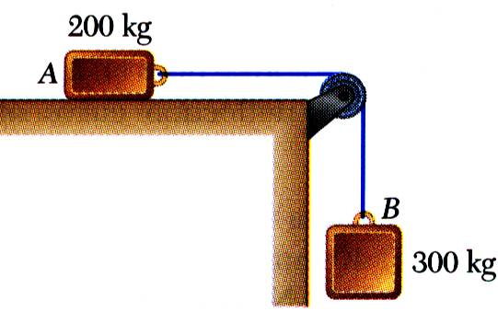
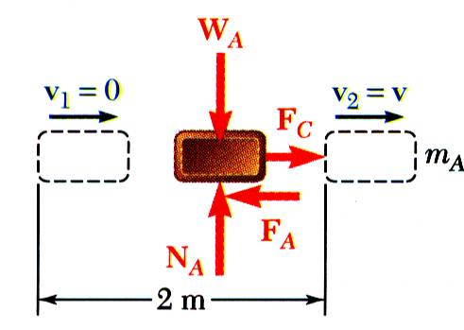
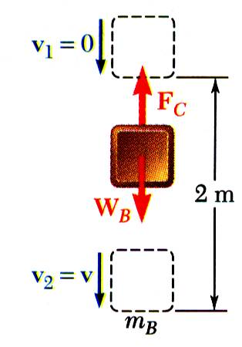
Sample Problem 2
SOLUTION:
Apply the principle of work and energy separately to blocks A and B.

Slide 19
Sample Problem 2
When the two relations are combined, the work of the cable forces cancel. Solve for the velocity.

Slide 20
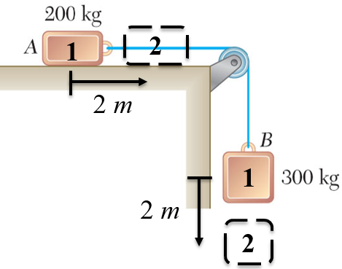
Alternate Solution, Group Problem Solving
Could you apply work-energy to the combined system of blocks?
Given: v₁= 0, distance = 2 m, μ_{k} = 0.25
What is T₁ of the system?
What is the total work done between points 1 and 2?
What is T₂ of the system?
Note that v_{A} = v_{B}
Solve for v

Slide 21
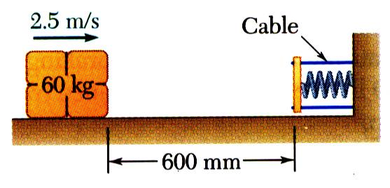
Sample Problem 3
SOLUTION:
Apply the principle of work and energy between the initial position and the point at which the spring is fully compressed and the velocity is zero. The only unknown in the relation is the friction coefficient.
Apply the principle of work and energy for the rebound of the package. The only unknown in the relation is the velocity at the final position.
A spring is used to stop a 60 kg package which is sliding on a horizontal surface. The spring has a constant k = 20 kN/m and is held by cables so that it is initially compressed 120 mm. The package has a velocity of 2.5 m/s in the position shown and the maximum deflection of the spring is 40 mm.
Determine (a) the coefficient of kinetic friction between the package and surface and (b) the velocity of the package as it passes again through the position shown.

Slide 22
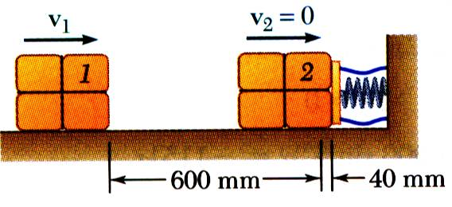
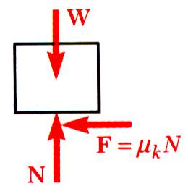
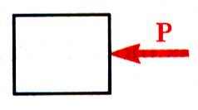
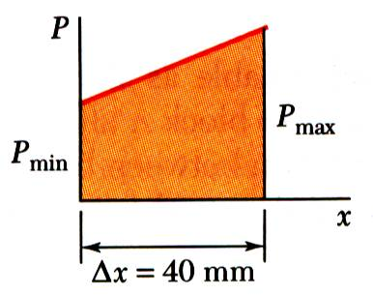
Sample Problem 3
SOLUTION:
Apply principle of work and energy between initial position and the point at which spring is fully compressed.

Slide 23
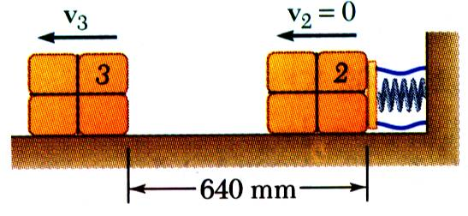
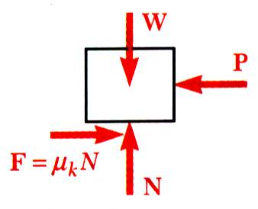
Sample Problem 3
Apply the principle of work and energy for the rebound of the package.

Slide 24
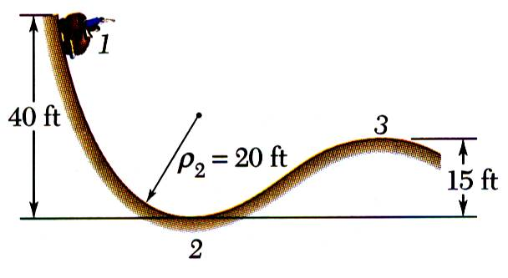
Sample Problem 4
SOLUTION:
Apply principle of work and energy to determine velocity at point 2.
Apply Newton’s second law to find normal force by the track at point 2.
Apply principle of work and energy to determine velocity at point 3.
A 2000 lb car starts from rest at point 1 and moves without friction down the track shown.
Apply Newton’s second law to find minimum radius of curvature at point 3 such that a positive normal force is exerted by the track.
Determine:
the force exerted by the track on the car at point 2, and
the minimum safe value of the radius of curvature at point 3.

Slide 25
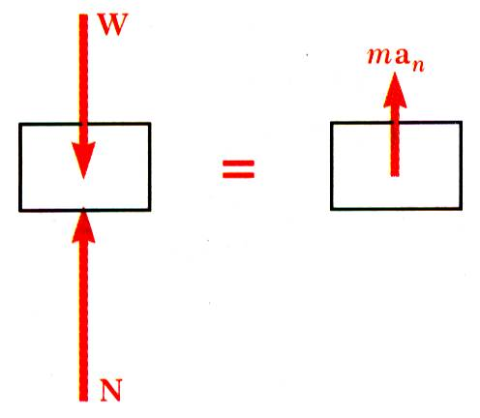
Sample Problem 4
SOLUTION:
Apply principle of work and energy to determine velocity at point 2.
Apply Newton’s second law to find normal force by the track at point 2.

Slide 26
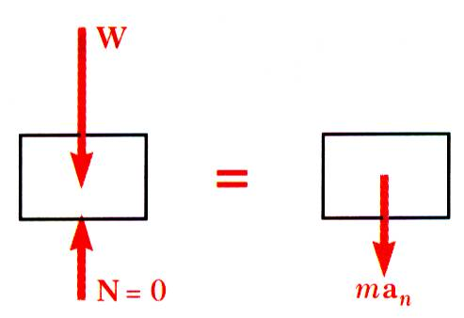
Sample Problem 4
Apply principle of work and energy to determine velocity at point 3.
Apply Newton’s second law to find minimum radius of curvature at point 3 such that a positive normal force is exerted by the track.

Slide 27
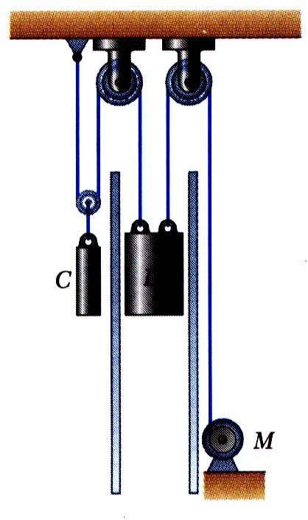
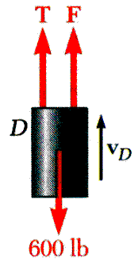
Sample Problem 5
SOLUTION:
Force exerted by the motor cable has same direction as the dumbwaiter velocity. Power delivered by motor is equal to Fv_{D}, v_{D} = 8 ft/s.
In the first case, bodies are in uniform motion. Determine force exerted by motor cable from conditions for static equilibrium.
In the second case, both bodies are accelerating. Apply Newton’s second law to each body to determine the required motor cable force.
The dumbwaiter D and its load have a combined weight of 600 lb, while the counterweight C weighs 800 lb. Determine the power delivered by the electric motor M when the dumbwaiter (a) is moving up at a constant speed of 8 ft/s and (b) has an instantaneous velocity of 8 ft/s and an acceleration of 2.5 ft/s², both directed upwards.

Slide 28
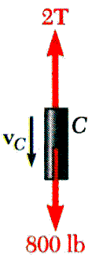
Sample Problem 5
In the first case, bodies are in uniform motion. Determine force exerted by motor cable from conditions for static equilibrium.
Free-body C:
Free-body D:

Slide 29
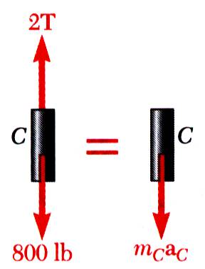
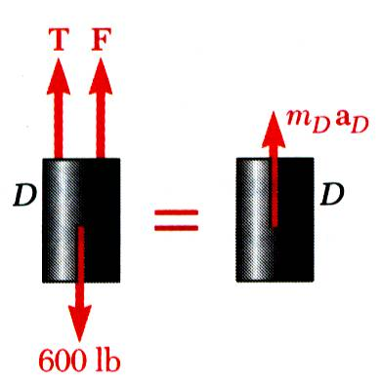
Sample Problem 5
In the second case, both bodies are accelerating. Apply Newton’s second law to each body to determine the required motor cable force.
Free-body C:
Free-body D:

Slide 30
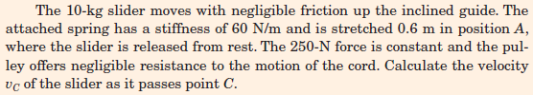
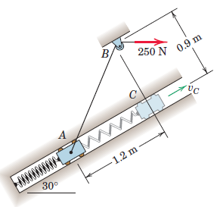
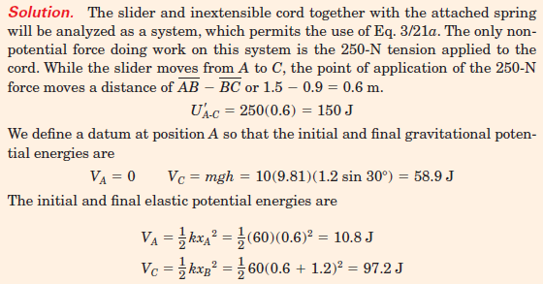
Sample Problem 6

Slide 31
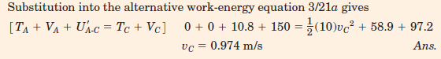
Sample Problem 6

Slide 32
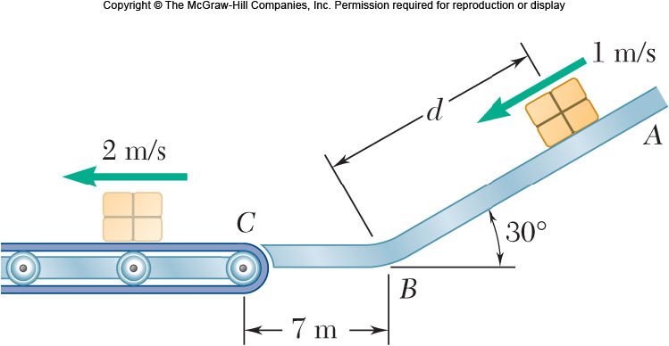
Group Problem Solving
SOLUTION: The problem deals with a change in position and different velocities, so use work-energy.
Draw FBD of the box to help us determine the forces that do work.
Determine the work done between points A and C as a function of d.
Packages are thrown down an incline at A with a velocity of 1 m/s. The packages slide along the surface ABC to a conveyor belt which moves with a velocity of 2 m/s. Knowing that μ_{k}= 0.25 between the packages and the surface ABC, determine the distance d if the packages are to arrive at C with a velocity of 2 m/s.
Find the kinetic energy at points A and C.
Use the work-energy relationship and solve for d.

Slide 33
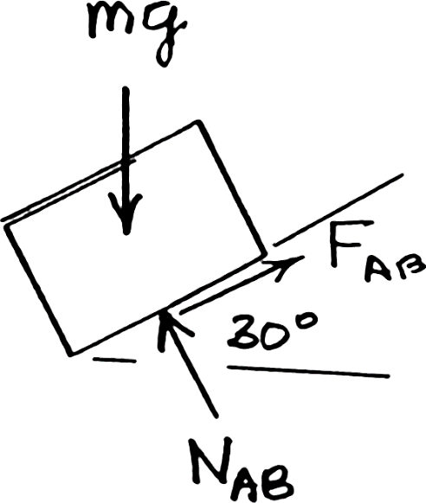
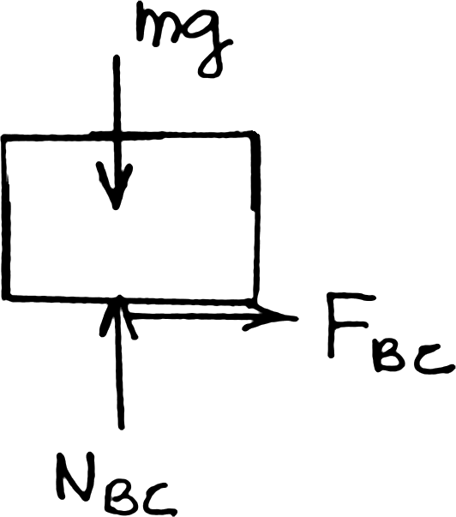
Group Problem Solving
SOLUTION: Given: v_{A}= 1 m/s, v_{C}= 2 m/s, μ_{k}= 0.25
Find: distance d
Will use:
Determine work done A → B
Draw the FBD of the block at points A and C
Determine work done B → C

Slide 34
Group Problem Solving
Determine kinetic energy at A and at C
Substitute values into
Divide by m and solve for d

Slide 35
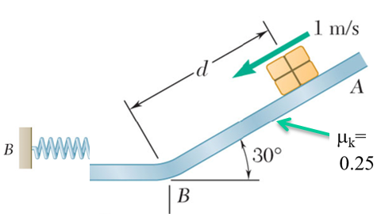
Concept Quiz
If you wanted to bring the package to a complete stop at the bottom of the ramp, would it work to place a spring as shown?
No, because the potential energy of the spring would turn into kinetic energy and push the block back up the ramp
Would the package ever come to a stop?
Yes, eventually enough energy would be dissipated through the friction between the package and ramp.

Slide 36
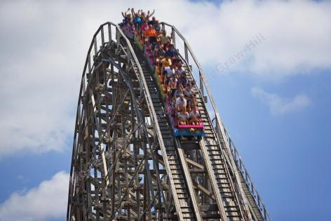
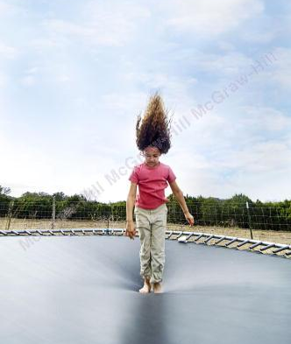
Potential Energy
The elastic potential energy stored in the trampoline is transferred to kinetic energy and gravitational potential energy as the girl flies upwards.
The potential energy stored at the top of the roller coaster is transferred to kinetic energy as the cars descend.

Slide 37
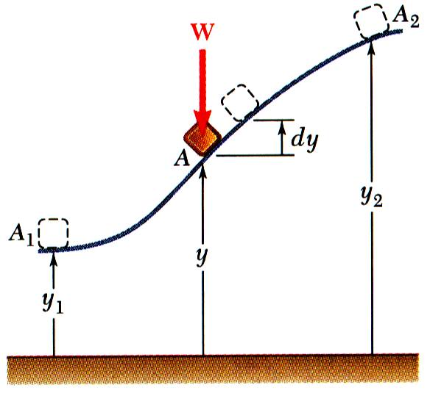
Potential Energy
Work of the force of gravity W=mg,
Work is independent of path followed; depends only on the initial and final values of Wy.
potential energy of the body with respect to force of gravity.
Choice of datum from which the elevation y is measured is arbitrary.
Units of work and potential energy are the same:

Slide 38
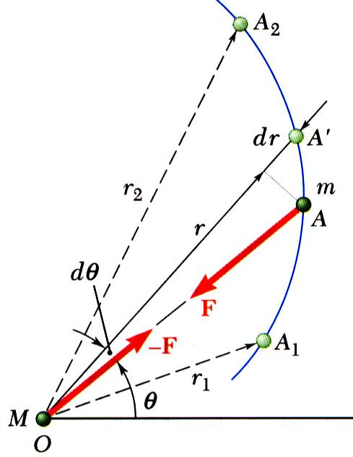
Potential Energy
Previous expression for potential energy of a body with respect to gravity is only valid when the weight of the body can be assumed constant.
For a space vehicle, the variation of the force of gravity with distance from the center of the earth should be considered.
Work of a gravitational force,
Potential energy V_{g} when the variation in the force of gravity can not be neglected,

Slide 39
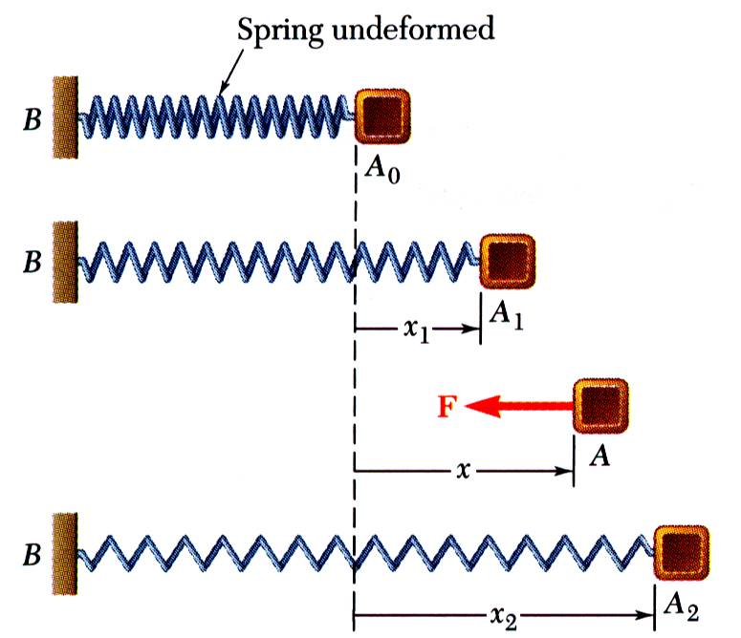

Potential Energy
Work of the force exerted by a spring depends only on the initial and final deflections of the spring,
The potential energy of the body with respect to the elastic force,
Note that the preceding expression for V_{e} is valid only if the deflection of the spring is measured from its undeformed position.

Slide 40

Sample Problem 7
SOLUTION:
Apply the principle of conservation of energy between positions 1 and 2.
The elastic and gravitational potential energies at 1 and 2 are evaluated from the given information. The initial kinetic energy is zero.
Solve for the kinetic energy and velocity at 2.
A 20 lb collar slides without friction along a vertical rod as shown. The spring attached to the collar has an undeflected length of 4 in. and a constant of 3 lb/in.
If the collar is released from rest at position 1, determine its velocity after it has moved 6 in. to position 2.

Slide 41


Sample Problem 7
SOLUTION:
Apply the principle of conservation of energy between positions 1 and 2.
Position 1:
Position 2:
Conservation of Energy:

Slide 42

Sample Problem 8
SOLUTION:
Since the pellet must remain in contact with the loop, the force exerted on the pellet must be greater than or equal to zero. Setting the force exerted by the loop to zero, solve for the minimum velocity at D.
Apply the principle of conservation of energy between points A and D. Solve for the spring deflection required to produce the required velocity and kinetic energy at D.
The 0.5 lb pellet is pushed against the spring and released from rest at A. Neglecting friction, determine the smallest deflection of the spring for which the pellet will travel around the loop and remain in contact with the loop at all times.

Slide 43


Sample Problem 8
SOLUTION:
Setting the force exerted by the loop to zero, solve for the minimum velocity at D.
Apply the principle of conservation of energy between points A and D.

Slide 44


Impulsive Motion
The thrust of a rocket acts over a specific time period to give the rocket linear momentum.
The impulse applied to the railcar by the wall brings its momentum to zero. Crash tests are often performed to help improve safety in different vehicles.

Slide 45

Principle of Impulse and Momentum
From Newton’s second law,
linear momentum
Dimensions of the impulse of a force are force*time.
Units for the impulse of a force are
The final momentum of the particle can be obtained by adding vectorially its initial momentum and the impulse of the force during the time interval.

Slide 46

Impulsive Motion
Force acting on a particle during a very short time interval that is large enough to cause a significant change in momentum is called an impulsive force.
When impulsive forces act on a particle,
When a baseball is struck by a bat, contact occurs over a short time interval but force is large enough to change sense of ball motion.
Non impulsive forces are forces for which is small and therefore, may be neglected – an example of this is the weight of the baseball.

Slide 47

Sample Problem 9
SOLUTION:
Apply the principle of impulse and momentum. The impulse is equal to the product of the constant forces and the time interval.
An automobile weighing 4000 lb is driven down a 5º incline at a speed of 60 mi/h when the brakes are applied, causing a constant total braking force of 1500 lb.
Determine the time required for the automobile to come to a stop.

Slide 48

Sample Problem 9
SOLUTION:
Apply the principle of impulse and momentum.
Taking components parallel to the incline,

Slide 49

Sample Problem 10
SOLUTION:
Apply the principle of impulse and momentum in terms of horizontal and vertical component equations.
A 4 oz baseball is pitched with a velocity of 80 ft/s. After the ball is hit by the bat, it has a velocity of 120 ft/s in the direction shown. If the bat and ball are in contact for 0.015 s, determine the average impulsive force exerted on the ball during the impact.

Slide 50

Sample Problem 10
SOLUTION:
Apply the principle of impulse and momentum in terms of horizontal and vertical component equations.
x component equation:
y component equation:
y
x

Slide 51

Sample Problem 11
SOLUTION:
Apply the principle of impulse and momentum to the package-cart system to determine the final velocity.
Apply the same principle to the package alone to determine the impulse exerted on it from the change in its momentum.
A 10 kg package drops from a chute into a 24 kg cart with a velocity of 3 m/s. Knowing that the cart is initially at rest and can roll freely, determine (a) the final velocity of the cart, (b) the impulse exerted by the cart on the package, and (c) the fraction of the initial energy lost in the impact.

Slide 52

Sample Problem 11
SOLUTION:
Apply the principle of impulse and momentum to the package-cart system to determine the final velocity.
y
x
x components:

Slide 53

Sample Problem 11
Apply the same principle to the package alone to determine the impulse exerted on it from the change in its momentum.
y
x
x components:
y components:

Slide 54
Sample Problem 11
To determine the fraction of energy lost,

Slide 55

Sample Problem 12
SOLUTION:
Draw impulse and momentum diagrams of the jumper.
Apply the principle of impulse and momentum to the jumper to determine the force exerted on the foot.
The jumper approaches the takeoff line from the left with a horizontal velocity of 10 m/s, remains in contact with the ground for 0.18 s, and takes off at a 50º angle with a velocity of 12 m/s. Determine the average impulsive force exerted by the ground on his foot. Give your answer in terms of the weight W of the athlete.

Slide 56

Group Problem Solving
Given: v₁ = 10 m/s, v₂= 12 m/s at 50º,
Δt= 0.18 s
Find: F_{avg} in terms of W
Draw impulse and momentum diagrams of the jumper
Use the impulse momentum equation in y to find F_{avg}

Slide 57
Group Problem Solving
Use the impulse momentum equation in x and y to find F_{avg}
F_{avg-x} is positive, which means we guessed correctly (acts to the left)

Slide 58

Group Problem Solving
Car A and B crash into one another. Looking only at the impact, which of the following statements are true?
The total mechanical energy is the same before and after the impact
True
False
If car A weighs twice as much as car B, the force A exerts on car B is bigger than the force B exerts on car A.
True
False
The total linear momentum is the same immediately before and after the impact
True
False

Slide 59



Concepts
The coefficient of restitution is used to characterize the “bounciness” of different sports equipment. The U.S. Golf Association limits the COR of golf balls at 0.83
Civil engineers use the coefficient of restitution to model rocks falling from hillsides

Slide 60


Impact
Impact: Collision between two bodies which occurs during a small time interval and during which the bodies exert large forces on each other.
Line of Impact: Common normal to the surfaces in contact during impact.
Impact involves (a) material deformation and recovery (in case there is no recovery, the deformation is plastic) and (b) generation of heat and sound.
Magnitude of force generated and duration of impact depend on: (a) shape of the bodies, (b) their velocities and (c) their elastic properties.
Direct Central Impact
Types of Impact
Central Impact: Impact for which the mass centers of the two bodies lie on the line of impact; otherwise, it is an eccentric impact..
Direct Impact: Impact for which the velocities of the two bodies are directed along the line of impact.
Oblique Impact: Impact for which one or both of the bodies move along a line other than the line of impact.
Oblique Central Impact

Slide 61



Direct Central Impact
Before impact
During impact
(maximum deformation happens)
After impact
Bodies moving in the same straight line, v_{A} > v_{B} .
Upon impact the bodies undergo a period of deformation, at the end of which, they are in contact and moving at a common velocity.
A period of restitution follows during which the bodies either regain their original shape or remain permanently deformed.
Wish to determine the final velocities of the two bodies. Because the contact forces are equal and opposite during impact, the total momentum of the two body system is preserved,
A second relation between the final velocities is required.

Slide 62
Direct Central Impact
Plastic Impact:
If the material is absolutely inelastic, like putty, they continue to move together with the same speed.
Owing to the absence of elastic forces there is no tendency for rebound.
Elastic Impact:
Hardened polished steel or glass ball approach this condition if the local deformation during impact is not excessive.
In addition to the momentum equation (Eq. 1), total kinetic energy before and after impact is conserved.
Semi-elastic Impact:
In practice, there must be some loss of energy of the system during impact and therefore we expect some deviation from perfect elasticity.

Slide 63
Direct Central Impact
Newton’s experimental law states that :
Coefficient of restitution
Energy loss during impact
Note:
When e=0, Eq. (4a) reduces to Eq. (2), already derived for the case of plastic impact.
When e=1, we obtain Eq. (3) for elastic impact where the total energy and total momentum conserved.

Slide 64

Oblique Central Impact
Initial and Final velocities are not parallel.
Final velocities are unknown in magnitude and direction. Four equations are required.
Experimental evidence shows that
The momentum of each particle in tangential direction is conserved.
Total momentum of the two particles in normal direction is conserved.
Normal components of relative velocities before and after impact are related by the coefficient of restitution.

Slide 65

Problems Involving Energy and Momentum
Three methods for the analysis of kinetics problems:
Direct application of Newton’s second law
Method of work and energy
Method of impulse and momentum. Select the method best suited for the problem or part of a problem under consideration.

Slide 66

Sample Problem 14
SOLUTION:
Resolve ball velocity into components normal and tangential to wall.
Impulse exerted by the wall is normal to the wall. Component of ball momentum tangential to wall is conserved.
Assume that the wall has infinite mass so that wall velocity before and after impact is zero. Apply coefficient of restitution relation to find change in normal relative velocity between wall and ball, i.e., the normal ball velocity.
A ball is thrown against a frictionless, vertical wall. Immediately before the ball strikes the wall, its velocity has a magnitude v and forms angle of 30º with the horizontal. Knowing that e = 0.90, determine the magnitude and direction of the velocity of the ball as it rebounds from the wall.

Slide 67

Sample Problem 14
SOLUTION:
Resolve ball velocity into components parallel and perpendicular to wall.
Component of ball momentum tangential to wall is conserved.
t
Apply coefficient of restitution relation with zero wall velocity.
n

Slide 68

Sample Problem 15
SOLUTION:
Resolve the ball velocities into components normal and tangential to the contact plane.
Tangential component of momentum for each ball is conserved.
Total normal component of the momentum of the two ball system is conserved.
The magnitude and direction of the velocities of two identical frictionless balls before they strike each other are as shown. Assuming e = 0.9, determine the magnitude and direction of the velocity of each ball after the impact.
The normal relative velocities of the balls are related by the coefficient of restitution.
Solve the last two equations simultaneously for the normal velocities of the balls after the impact.

Slide 69


Sample Problem 15
SOLUTION:
Resolve the ball velocities into components normal and tangential to the contact plane.
Tangential component of momentum for each ball is conserved.
Total normal component of the momentum of the two ball system is conserved.

Slide 70

Sample Problem 15
The normal relative velocities of the balls are related by the coefficient of restitution.
Solve the last two equations simultaneously for the normal velocities of the balls after the impact.

Slide 71

Group Problem Solving
SOLUTION:
Determine orientation of impact line of action.
The momentum component of ball A tangential to the contact plane is conserved.
The total horizontal momentum of the two ball system is conserved.
The relative velocities along the line of action before and after the impact are related by the coefficient of restitution.
Solve the last two expressions for the velocity of ball A along the line of action and the velocity of ball B which is horizontal.
Ball B is hanging from an inextensible cord. An identical ball A is released from rest when it is just touching the cord and acquires a velocity v₀ before striking ball B. Assuming perfectly elastic impact (e = 1) and no friction, determine the velocity of each ball immediately after impact.

Slide 72



Group Problem Solving
SOLUTION:
Determine orientation of impact line of action.
The momentum component of ball A tangential to the contact plane is conserved.
The total horizontal (x component) momentum of the two ball system is conserved.

Slide 73


Group Problem Solving
The relative velocities along the line of action before and after the impact are related by the coefficient of restitution.
Solve the last two expressions for the velocity of ball A along the line of action and the velocity of ball B which is horizontal.

Slide 74

Sample Problem 17
SOLUTION:
Apply the principle of conservation of energy to determine the velocity of the block at the instant of impact.
Since the impact is perfectly plastic, the block and pan move together at the same velocity after impact. Determine that velocity from the requirement that the total momentum of the block and pan is conserved.
Apply the principle of conservation of energy to determine the maximum deflection of the spring.
A 30 kg block is dropped from a height of 2 m onto the 10 kg pan of a spring scale. Assuming the impact to be perfectly plastic, determine the maximum deflection of the pan. The constant of the spring is k = 20 kN/m.

Slide 75
Sample Problem 17
SOLUTION:
Apply principle of conservation of energy to determine velocity of the block at instant of impact.
Determine velocity just after impact from requirement that total momentum of the block and pan is conserved.

Slide 76

Sample Problem 17
Apply the principle of conservation of energy to determine the maximum deflection of the spring.
Initial spring deflection due to pan weight:

Slide 77

Group Problem Solving
SOLUTION:
This is a multiple step problem. Formulate your overall approach.
Use work-energy to find the velocity of the block just before impact
Use conservation of momentum to determine the speed of ball B after the impact
Use work energy to find the velocity at α
A 2-kg block A is pushed up against a spring compressing it a distance x= 0.1 m. The block is then released from rest and slides down the 20º incline until it strikes a 1-kg sphere B, which is suspended from a 1 m inextensible rope. The spring constant k=800 N/m, the coefficient of friction between A and the ground is 0.2, the distance A slides from the unstretched length of the spring d=1.5 m, and the coefficient of restitution between A and B is 0.8. When α=40º, find (a) the speed of B (b) the tension in the rope.
Use Newton’s 2nd Law to find tension in the rope

Slide 78

Group Problem Solving
Given: m_{A}= 2-kg m_{B}= 1-kg, k= 800 N/m, μ_{A} =0.2, e= 0.8
Find (a) v_{B} (b) T_{rope}
Use work-energy to find the velocity of the block just before impact
Determine the friction force acting on the block A
Solve for N
Sum forces in the y-direction

Slide 79


Group Problem Solving
Set your datum, use work-energy to determine v_{A} at impact.
Determine values for each term.
$T_{2}=\frac{1}{2}m_{A}V_{A}^{2}=\frac{1}{2}\left(2\right)V_{A}^{2}=1.00 V_{A}^{2}$, $V_{2}=0$
Substitute into the Work-Energy equation and solve for v_{A}
$$T_{1}+{\left(V_{1}\right)}_{e}+{\left(V_{1}\right)}_{g}+U_{1→2}=T_{2}+{\left(V_{2}\right)}_{e}+{\left(V_{2}\right)}_{g}:0+4.00+10.7367−5.8998=1.00 V_{A}^{2}+0$$

Slide 80

Group Problem Solving
Use conservation of momentum to determine the speed of ball B after the impact
Draw the impulse diagram
Note that the ball is constrained to move only horizontally immediately after the impact.
Use the relative velocity/coefficient of restitution equation
Apply conservation of momentum in the x direction
(1)
(2)
Solve (1) and (2) simultaneously

Slide 81

Group Problem Solving
Use work energy to find the velocity at α
Set datum, use Work-Energy to determine v_{B} at α= 40º
Determine values for each term.
Substitute into the Work-Energy equation and solve for v_{A}

Slide 82

Group Problem Solving
Use Newton’s 2nd Law to find tension in the rope
Draw your free-body and kinetic diagrams
Determine normal acceleration
Sum forces in the normal direction
Substitute and solve

Slide 83
Concept Question
Compare the following statement to the problem you just solved.
If the coefficient of restitution is smaller than the 0.8 in the problem, the tension T will be…
Smaller
Bigger
If the rope length is smaller than the 1 m in the problem, the tension T will be…
Smaller
Bigger
If the mass of A is smaller than the 2 kg given in the problem, the tension T will be…
If the coefficient of friction is smaller than 0.2 given in the problem, the tension T will be…
Smaller
Bigger
Smaller
Bigger

Slide 84
Summary
Approaches to Kinetics Problems
Forces and Accelerations
Velocities and Displacements
Velocities and Time
Newton’s Second Law (last chapter)
Work-Energy
Impulse-Momentum

Slide 85
Acknowledgement
NPTEL lectures on Engineering Mechanics
Beer & Johnston, Vector Mechanics for Engineers
Meriam & Kraige, Engineering Mechanics
Problems taken from internet sources
Timoshenko & Young, Engineering Mechanics

